Slide 1
IDsurv.org
An innovative Infectitious Disease and Serious AEFI surveillance system

Slide 2
How do I join IDsurv.org?
Log on to
http://www.idsurv.org/
The following Screen will appear………

Slide 3
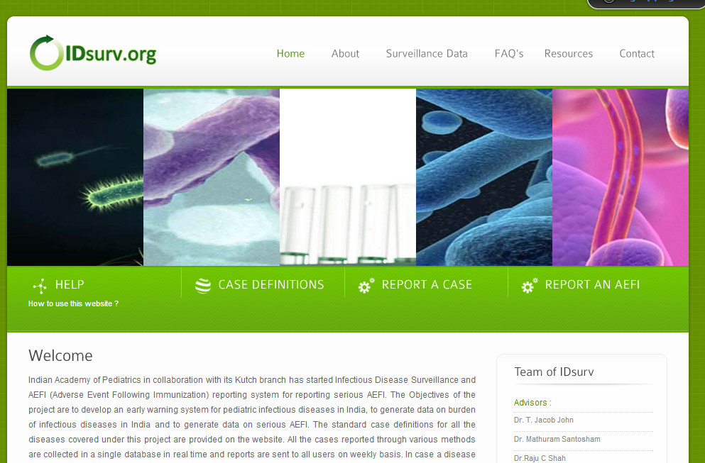

Slide 4
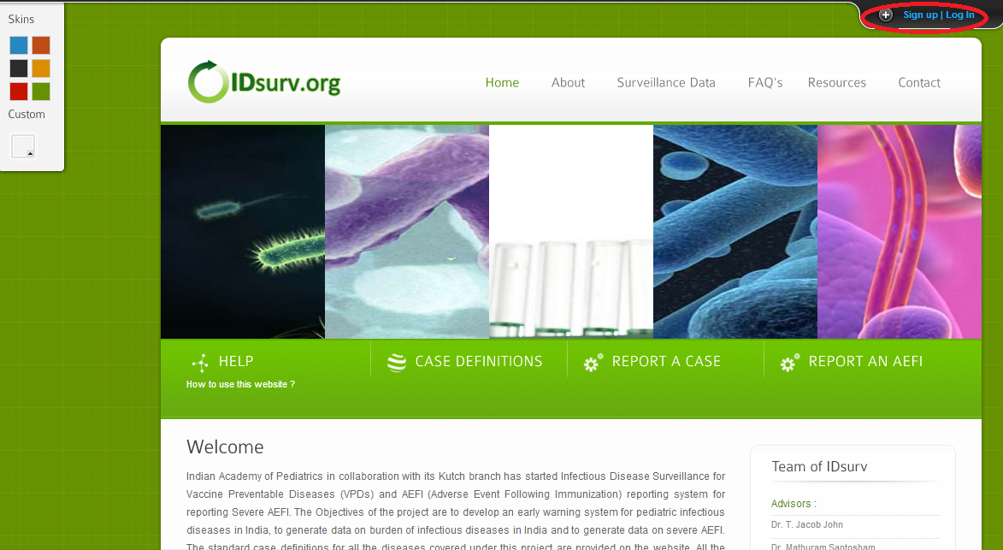
How to get registered?
Click on the ‘Sign up/ Log in’ button as shown below
Then the following panel will open……

Slide 5
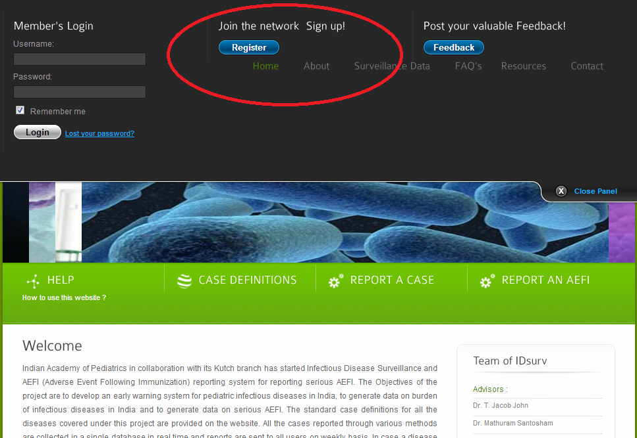
Click on “Register” button
Then the following form will appear……..

Slide 6
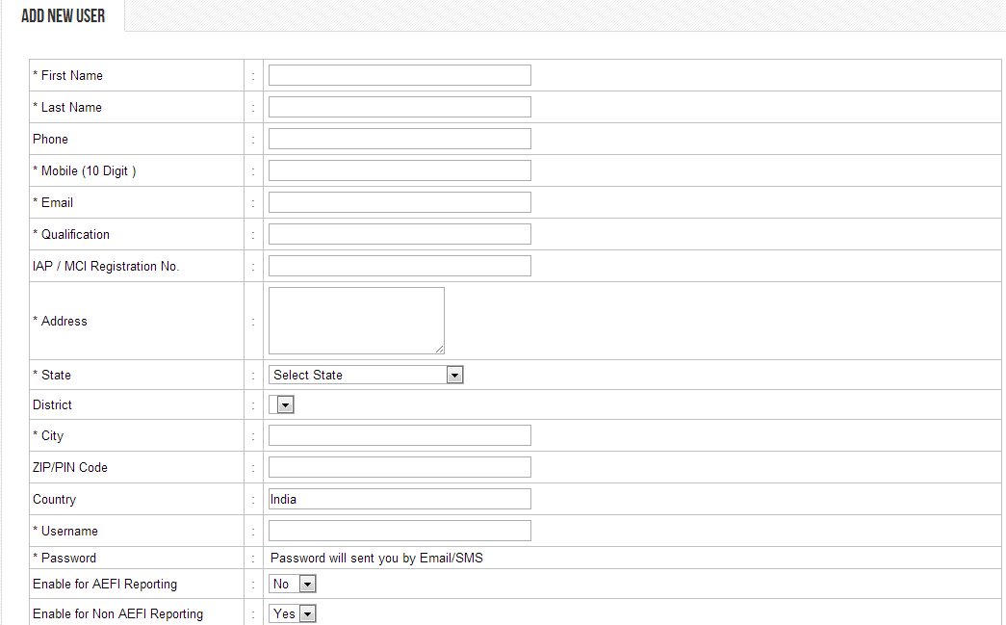
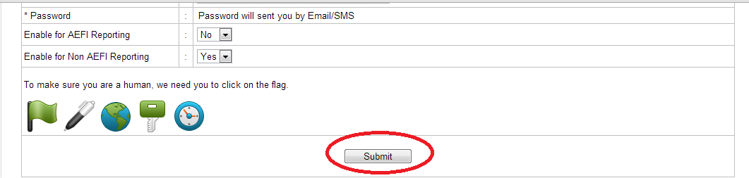
Click here

Slide 7
After submitting the form you will get your username and password, once your registration is verified and approved by the Administrator.

Slide 8
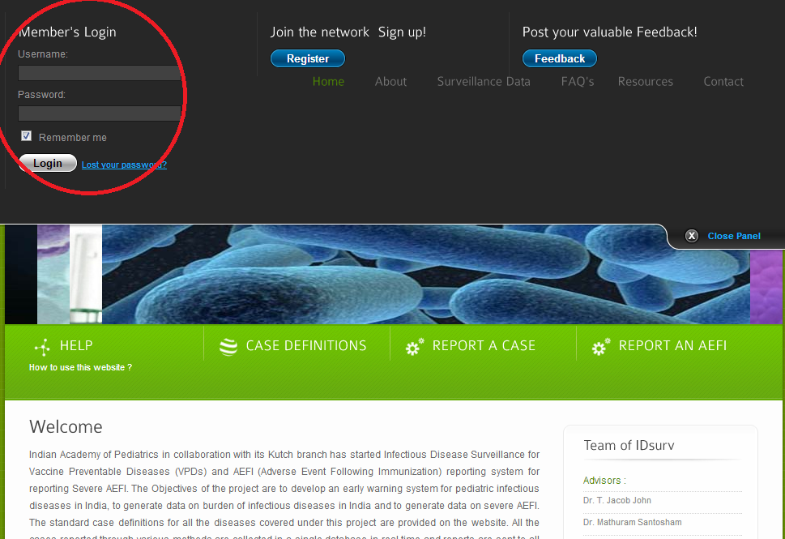
If you are already registered user Login from here

Slide 9
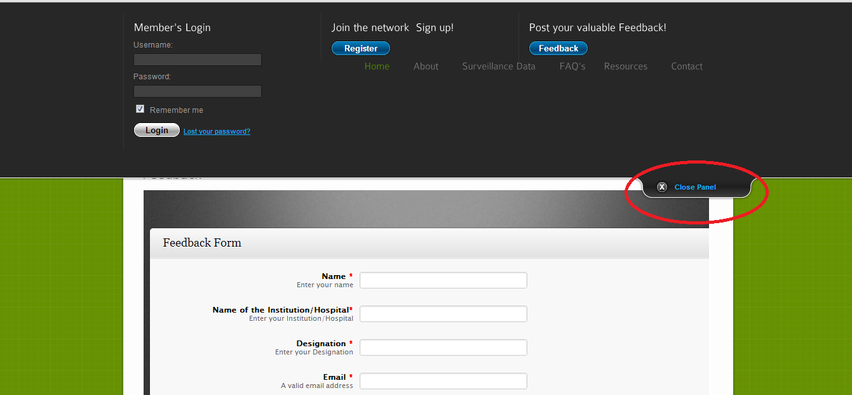

Slide 10
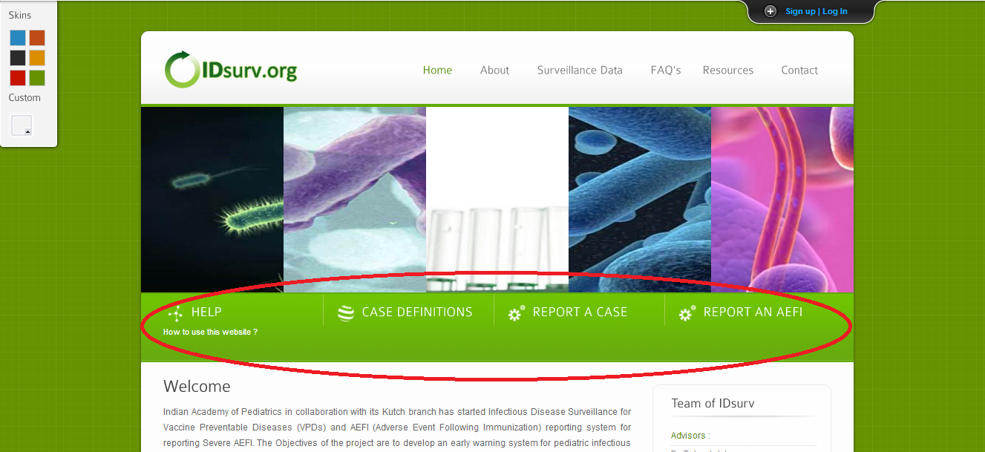
Shows the definition of 10 Diseases mentioned in ‘About us’
Shows how to use this Website?

Slide 11
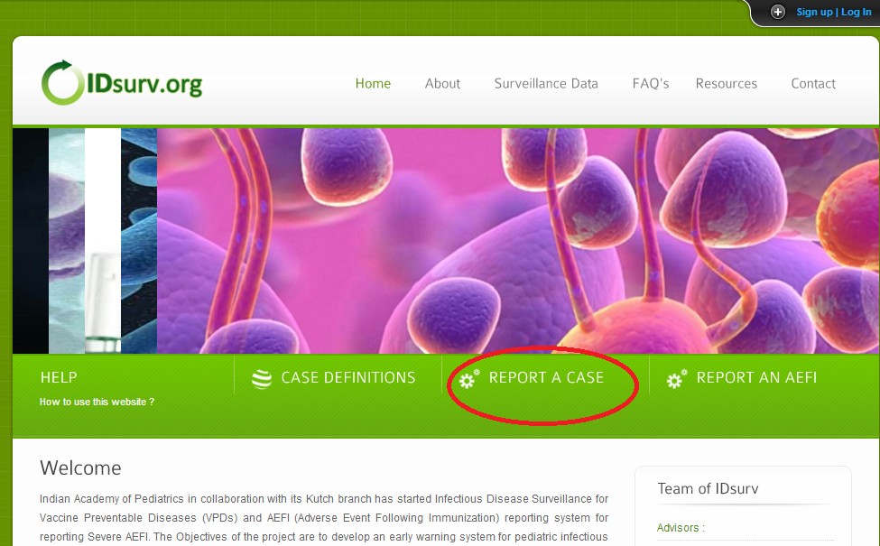
How to report a case?
Click on this Tab

Slide 12
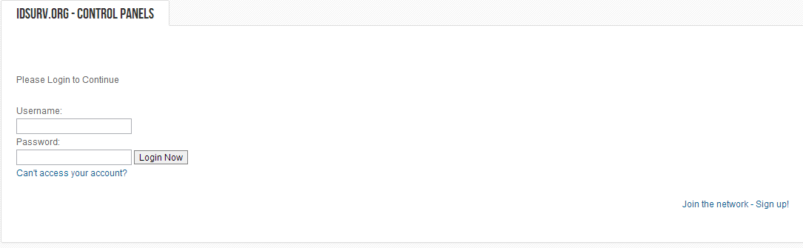
Enter your Username
Enter your Password
After ‘Login Now’ the following page appears………..

Slide 13
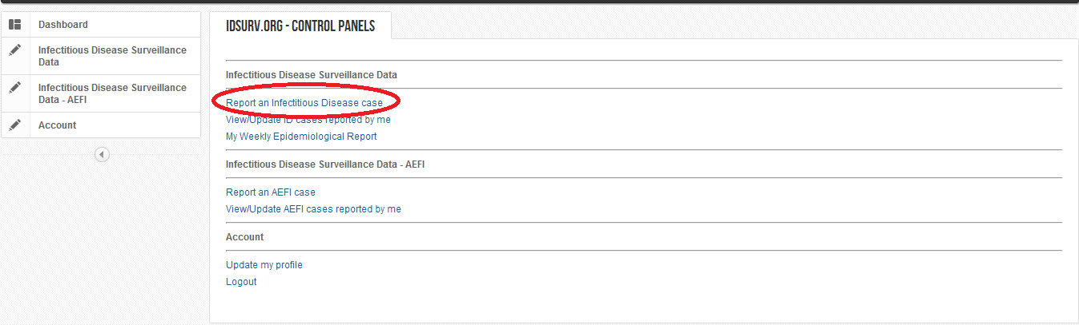
Click Here
Then the following form will appear……..

Slide 14
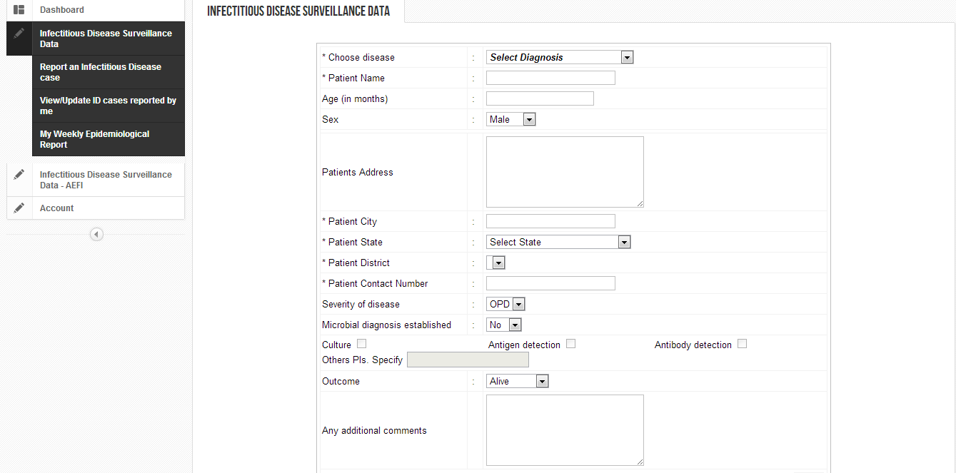
As you save the report, a reference number of your patient will be generated.

Slide 15
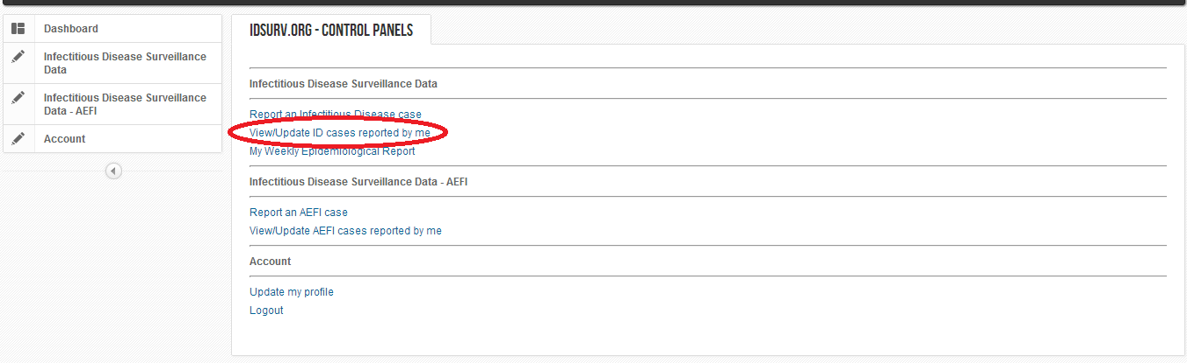
Click here to View/Update cases reported by you

Slide 16
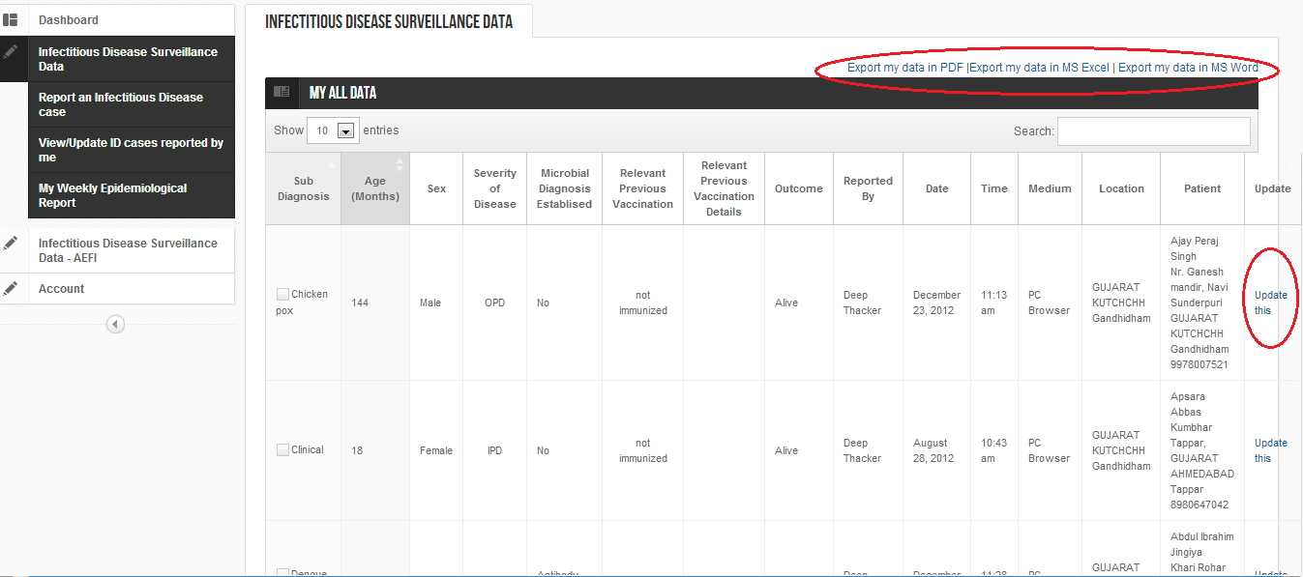
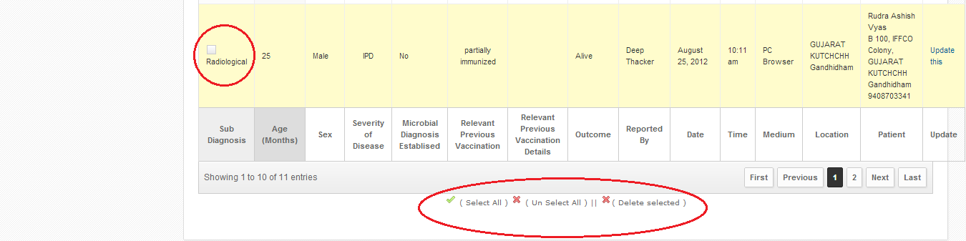
Here you can see all the cases reported by you.
Export From here
Search from here
Update Here
Unique Selection
Perform Actions

Slide 17
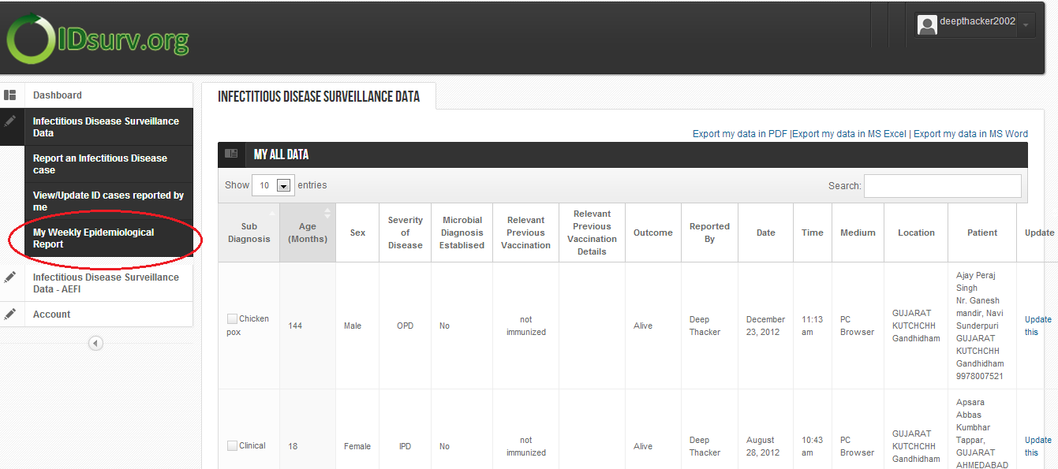
Click For Weekly Report

Slide 18
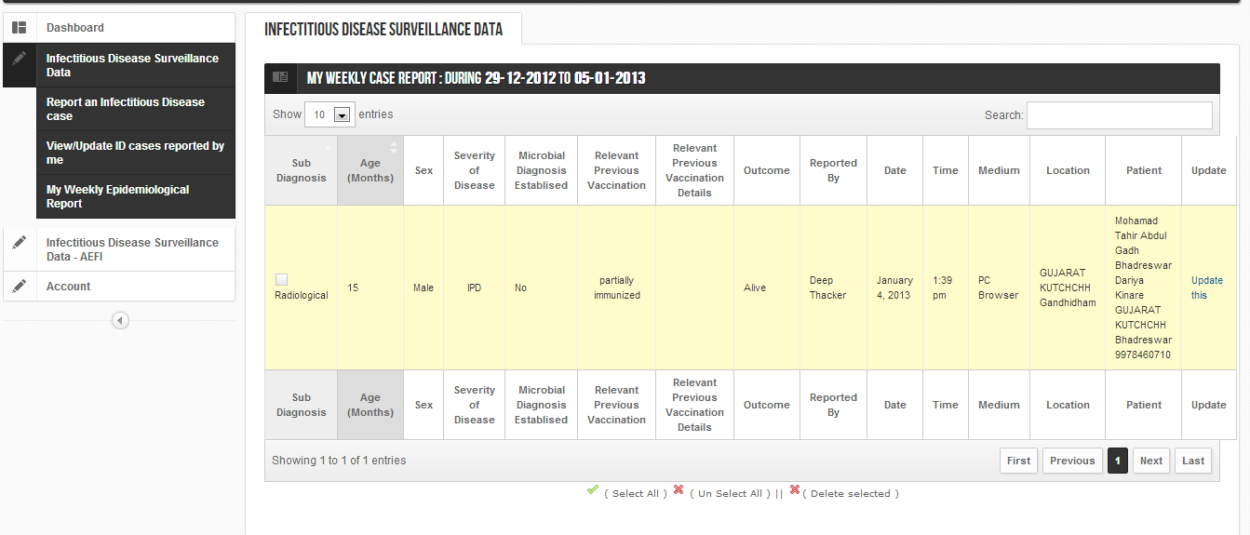
View of Your Weekly report

Slide 19
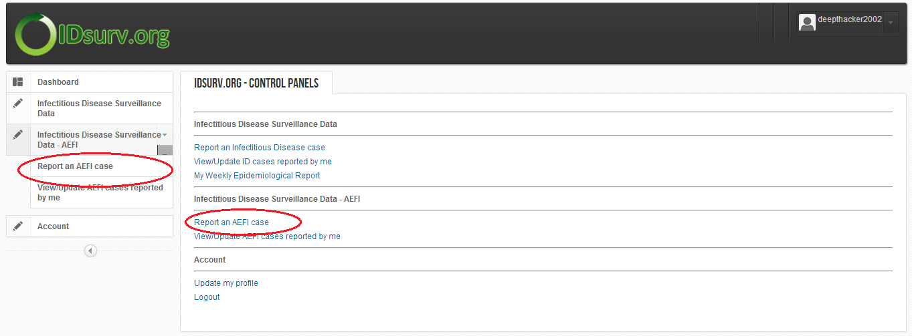
Click any to Report Serious AEFI

Slide 20
Report only Serious AEFI:
  Deaths
  Hospitalization
  Cluster
  Disability

Slide 21
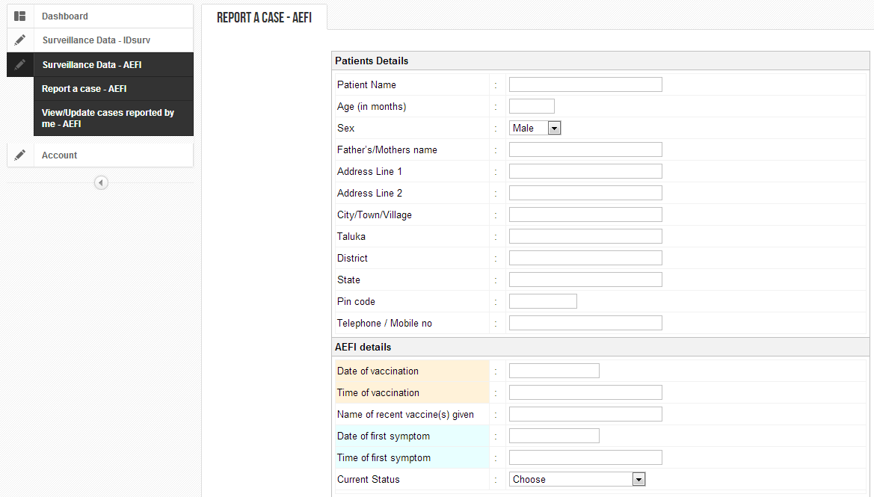
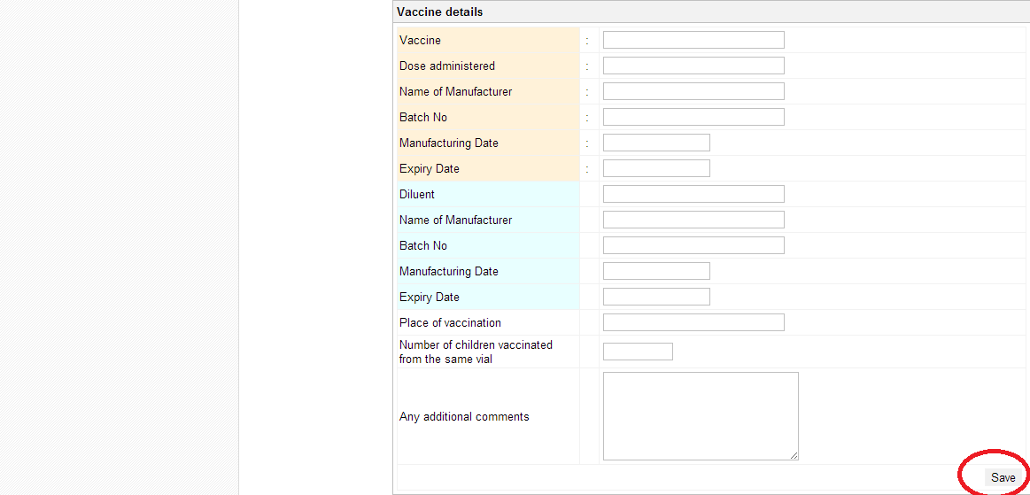
After filling form Click on Save

Slide 22
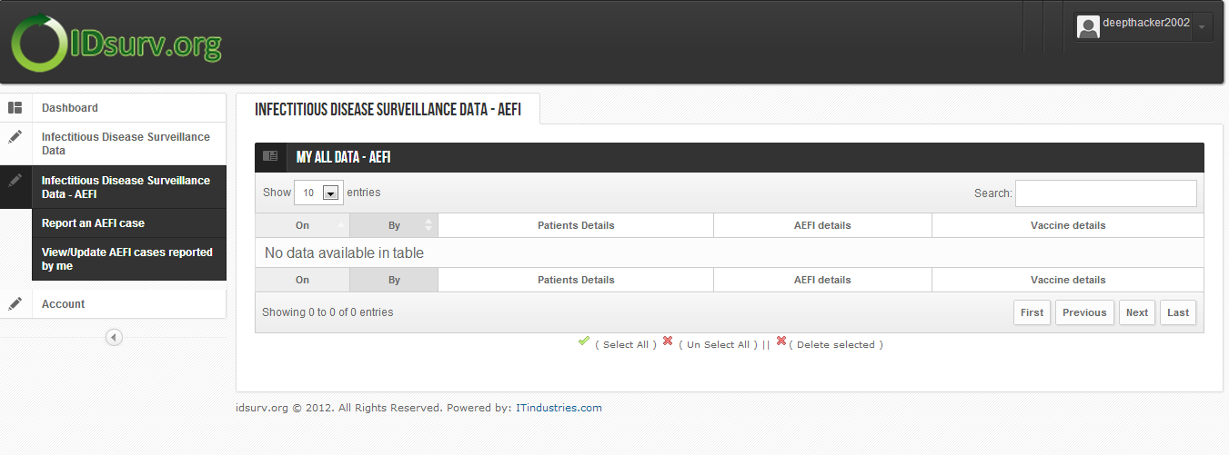
Here you can see all the AEFI cases reported by you.
Click Here
To View this Details

Slide 23
Other Ways of Reporting a Case

Slide 24
Reporting a case through sms:
Click here for more details and then, SMS appropriate codes to 57333.
Reporting case through mobile website:
Log in to your account on m.idsurv.org. Click on report a case and fill up the form and click on submit button.
Reporting a case through IVR:
To report a case using IVR system, call 02653090533 using your registered mobile number and follow the instructions

Slide 25
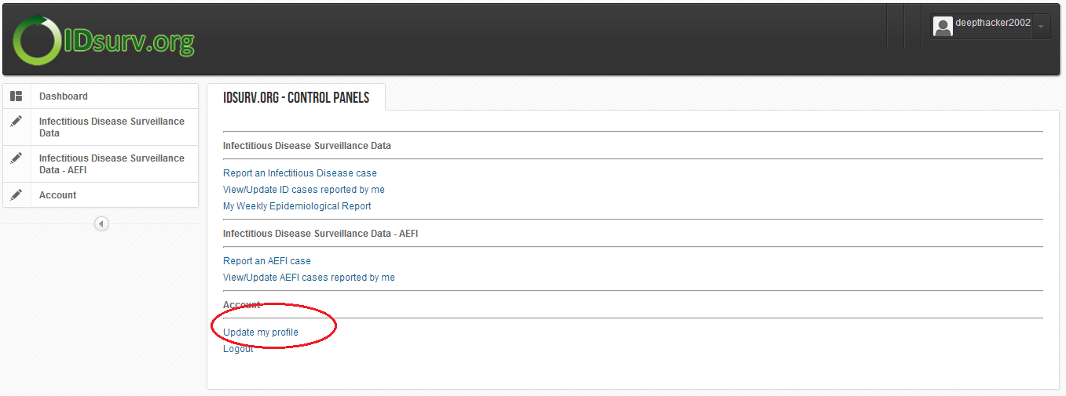
Click to Update Profile
Then Following Form will appear……

Slide 26
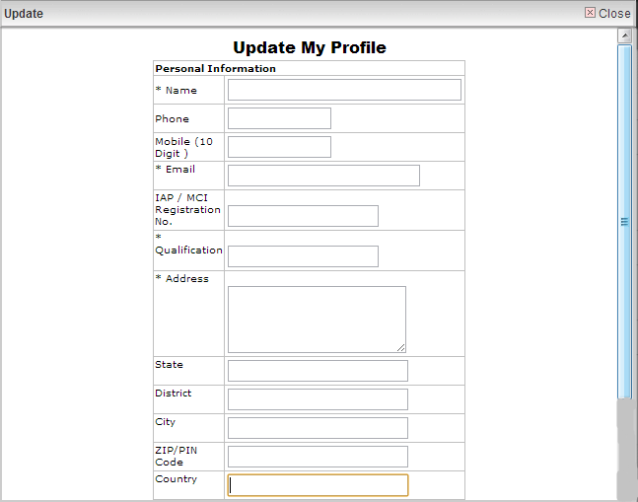

Click to update

Slide 27
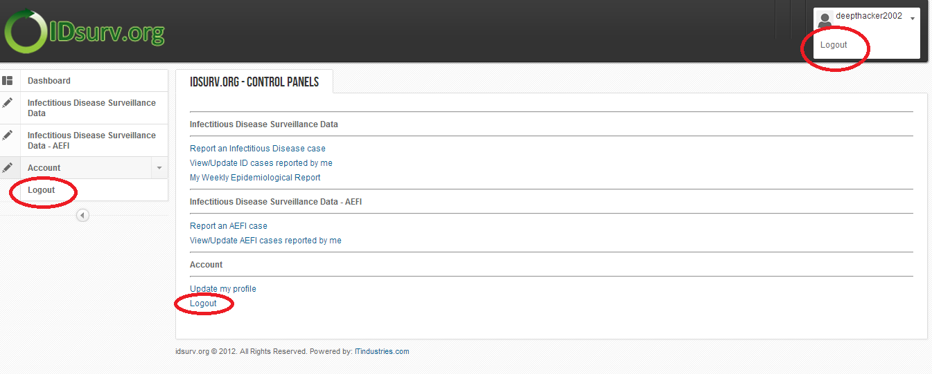
Click on any of the following “Logouts” after using ‘Control Panels’.

Slide 28
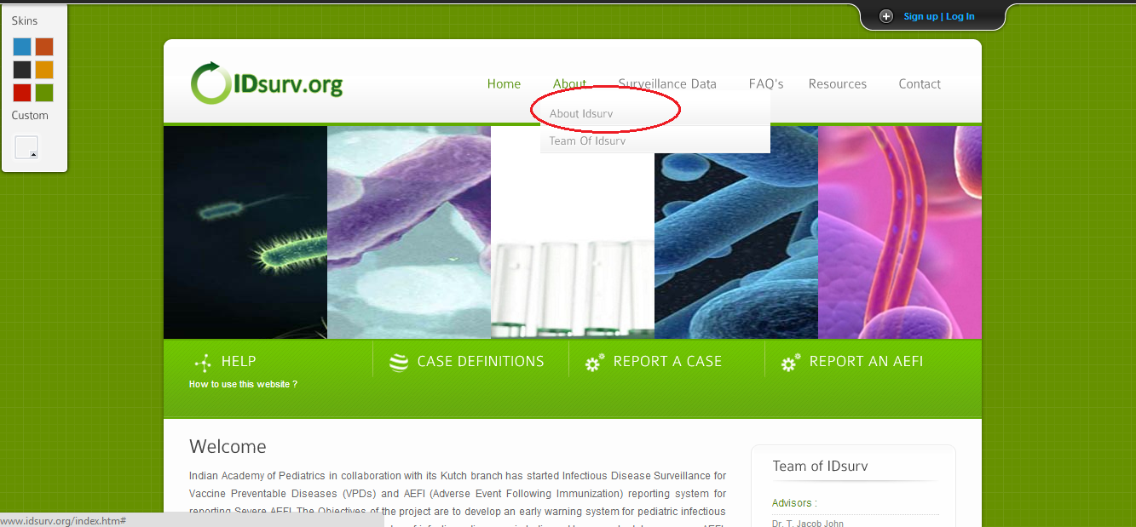
Click Here
Following Page will appear….

Slide 29
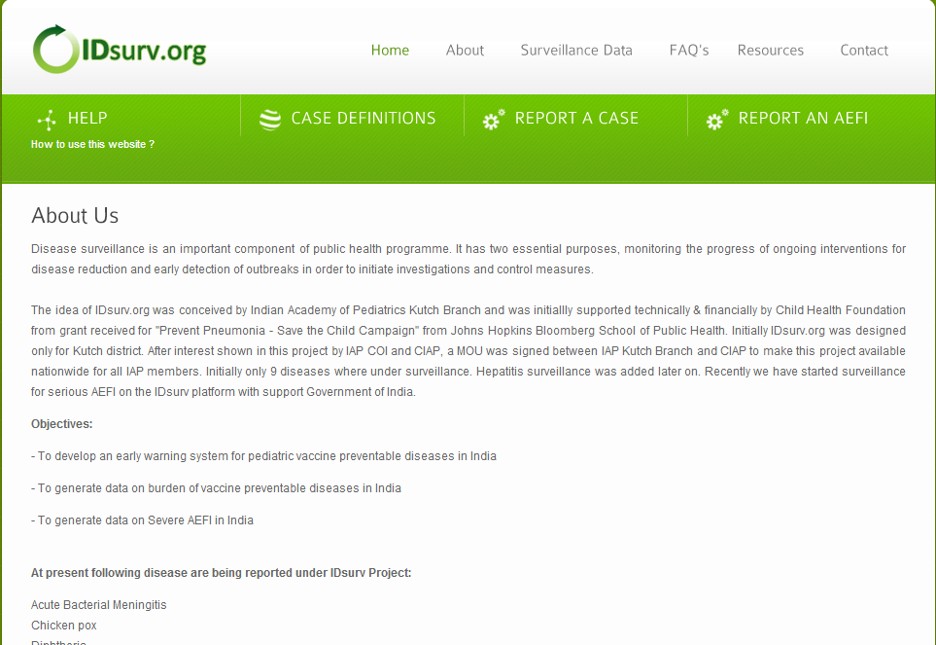
Shows Information about IDsurv

Slide 30
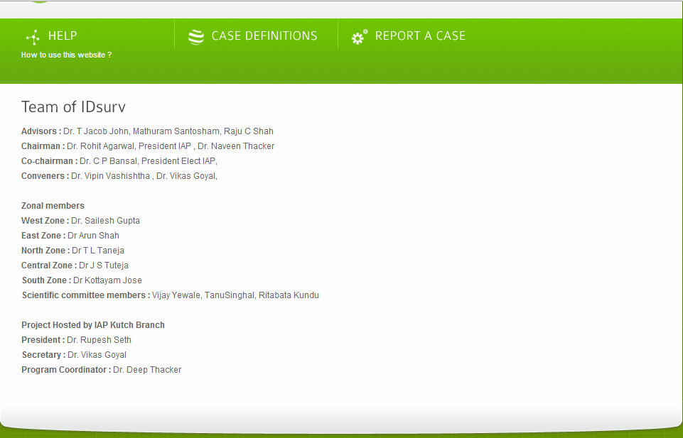
The Team of IDsurv

Slide 31
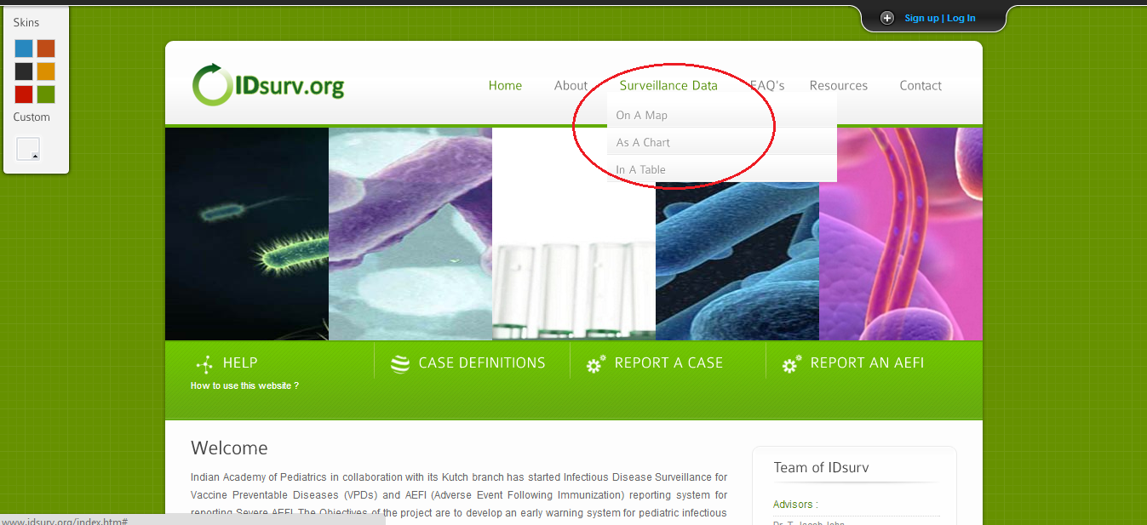
Surveillance data in different Formats

Slide 32
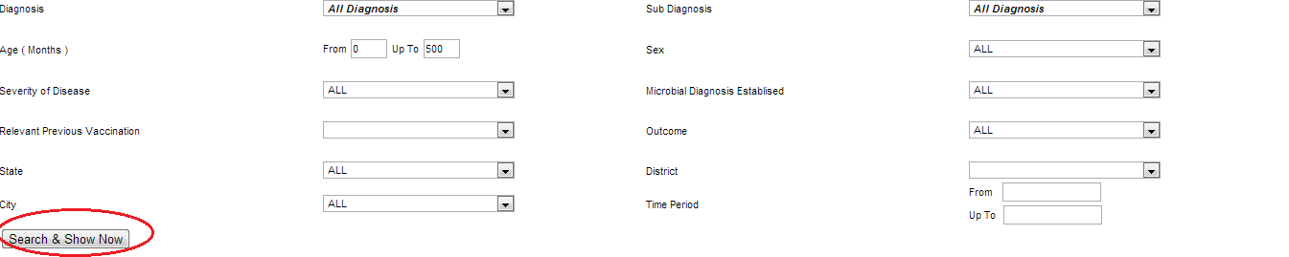
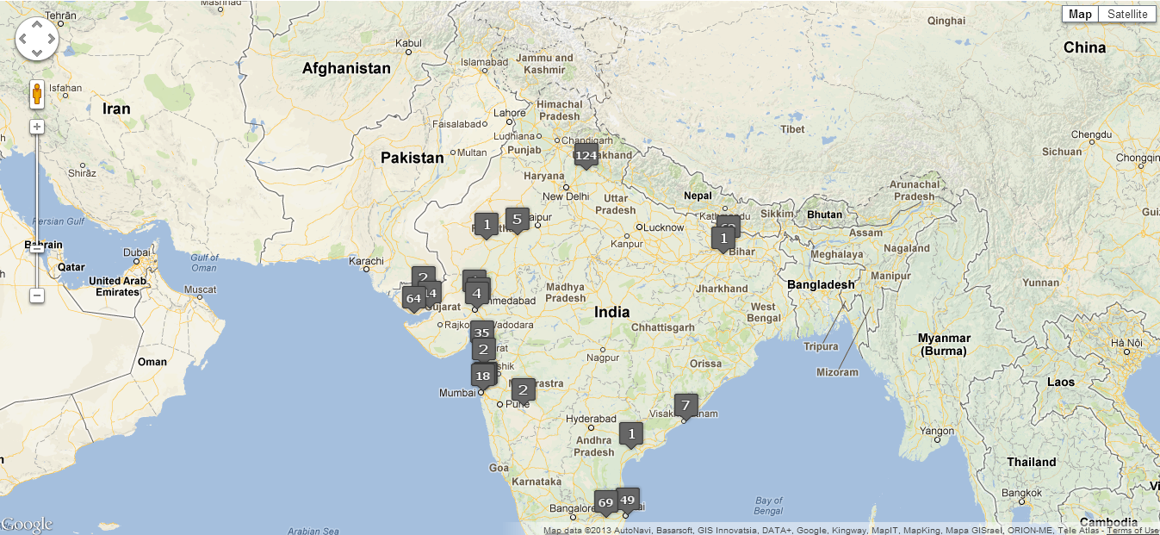
Surveillance data in Map format
Click here for customize search

Slide 33
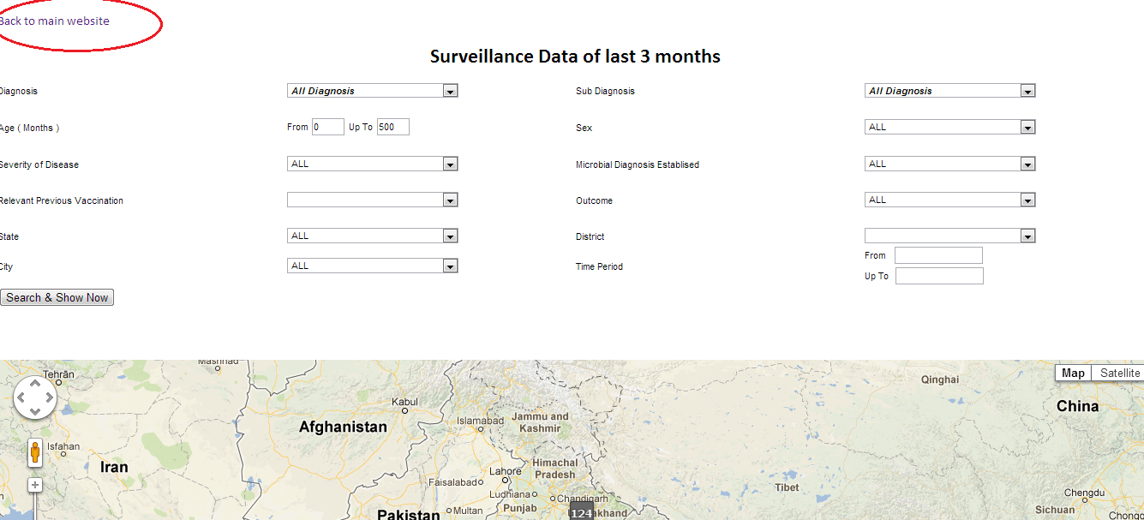
Click to go back to Home page

Slide 34
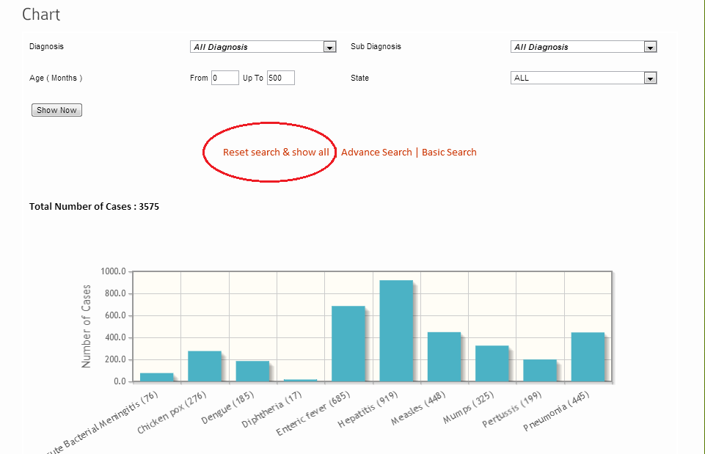
Default view of Surveillance chart

Slide 35
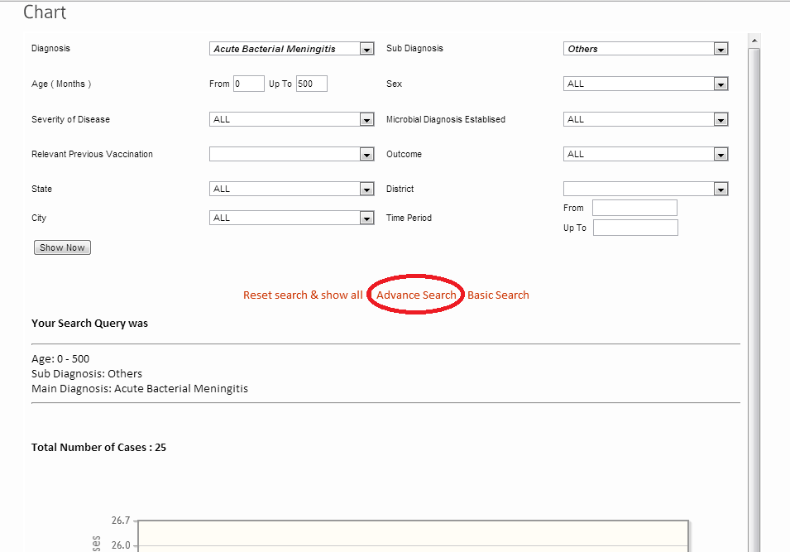
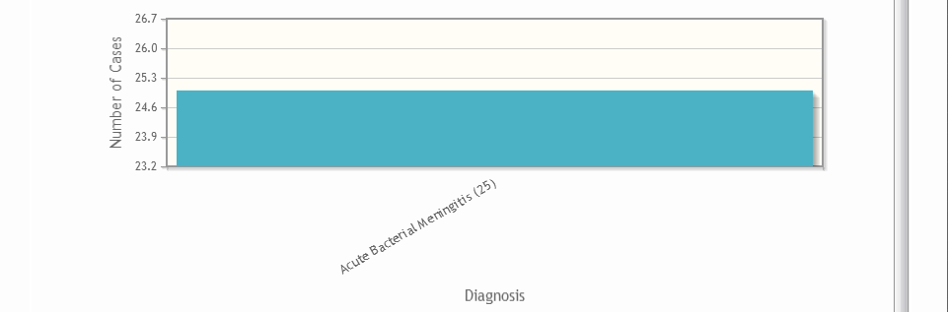
Surveillance data Basic search in Chart
Click to search
Continue……

Slide 36
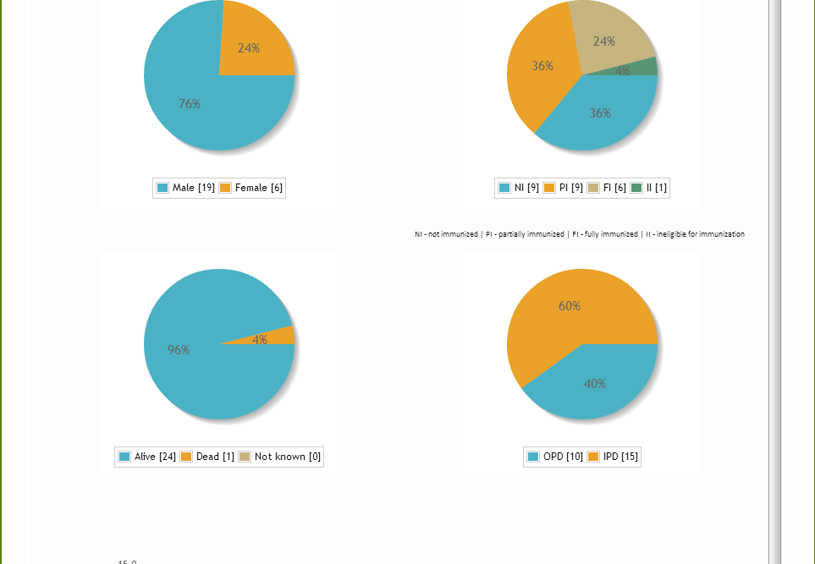
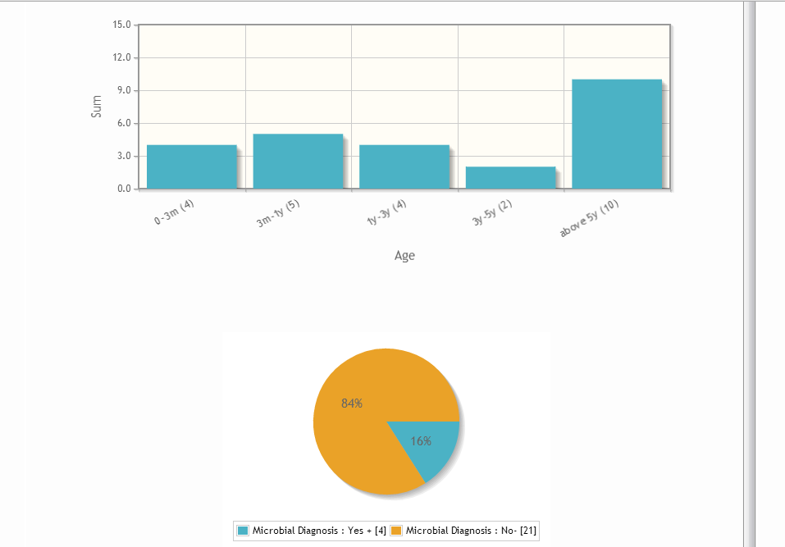

Slide 37
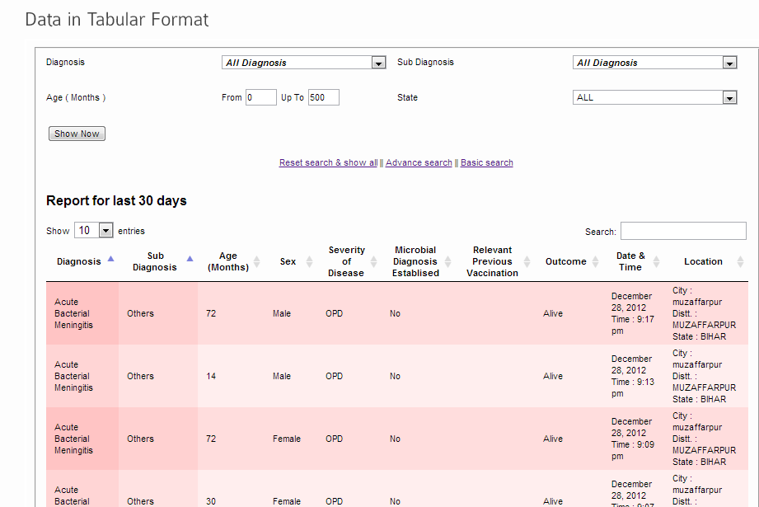
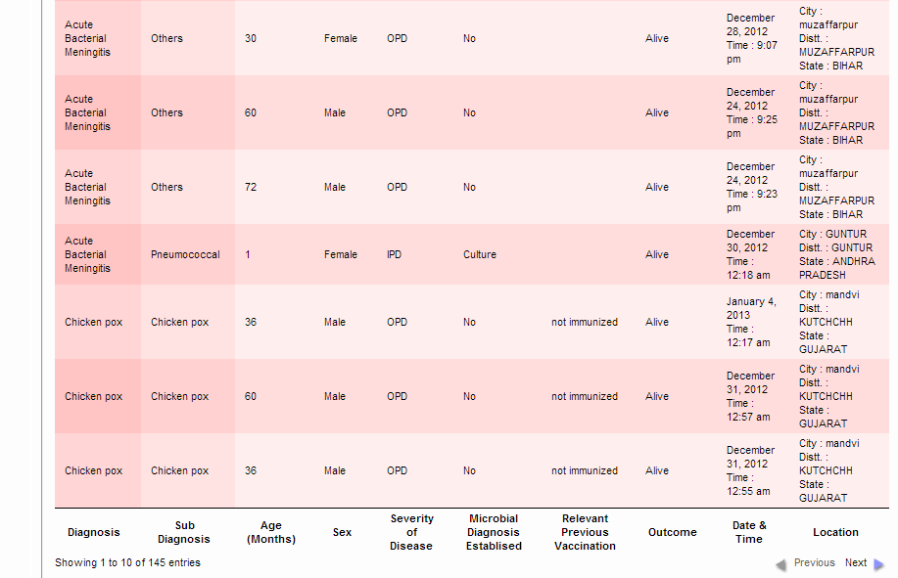
Surveillance data view in Tabular format

Slide 38

Click FAQ for getting answers of your Queries

Slide 39
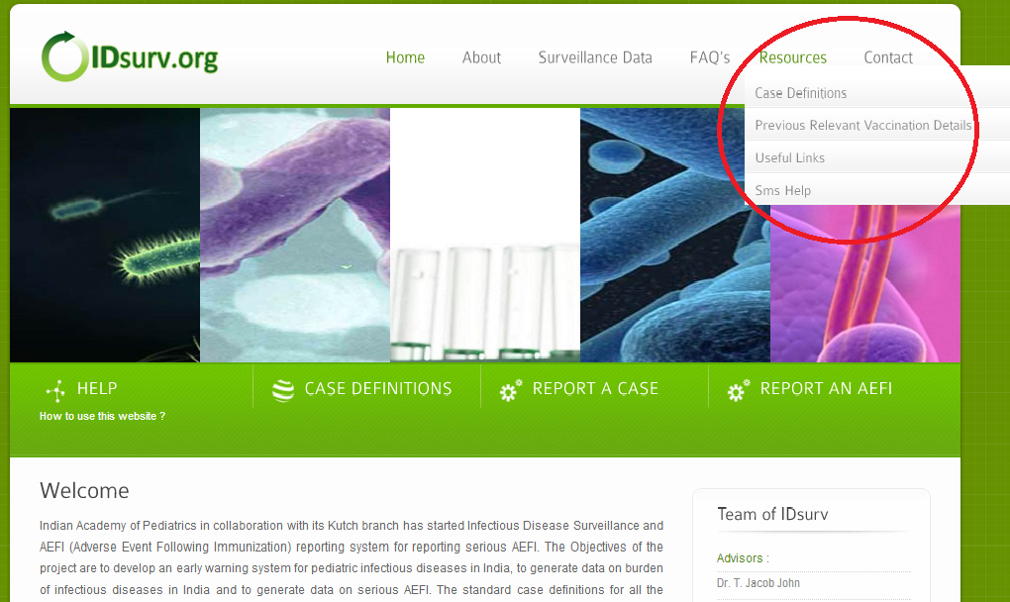
Resources

Slide 40
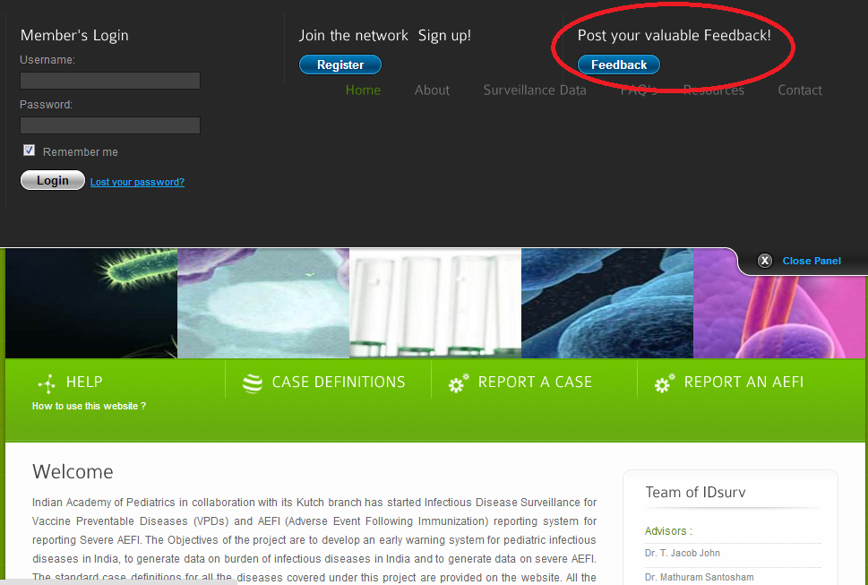
Post Your Valuable “Feedback”
After clicking on ‘Feedback’ the following form will appear…

Slide 41
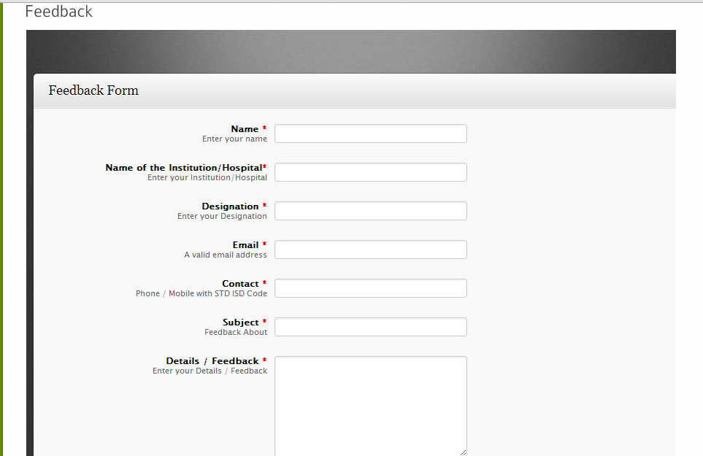
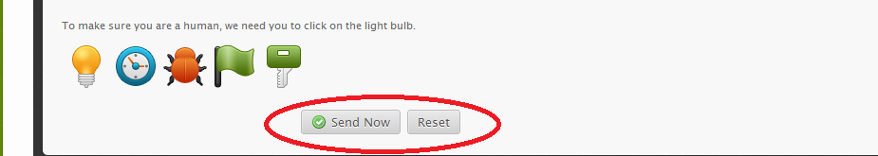
Click on ‘Send Now’ for sending your ‘Feedback’

Slide 42
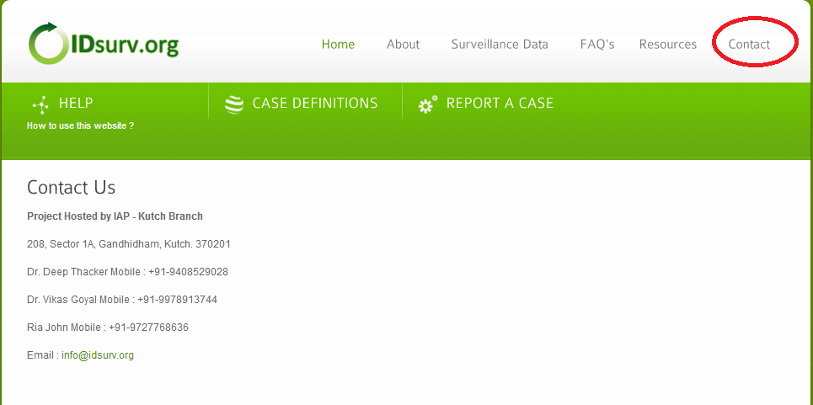
Contact Us

Slide 43
Thank you

